Slide 1
Housing Price Prediction
An Understanding of the Australian Market

Slide 2
Overview
Introduction
Problem Statement
Problem Analysis
Description of Customer Retention
Importance and Benefits of Customer Retention
Data Analysis of the DataSet
Understanding through Visualization
Assumption
Concluding Statement

Slide 3
Overview
A US-based housing company named Surprise Housing has decided to enter the Australian market. The company is looking at prospective properties to buy houses to enter the market. Thus, they need to have a basic understanding of the market and by analysing them understand the actual value of the prospective properties and decide whether to invest in them or not.

Slide 4
Introduction
According to a 2016 Gallup Poll[1], real estate was rated the best long-term investment – well ahead of gold, stocks and mutual funds, savings accounts/CDs and bonds. Hence, in order to make an investment in the real estate market, one needs to have a good understanding of the market trends. Analysing the real estate data can help in better understanding what the demands of the market is.
Houses are one of the necessary need of each and every person around the globe and therefore housing and real estate market is one of the markets which is one of the major contributors in the world’s economy. It is a very large market and there are various companies working in the domain.
Let’s take into account a set of data that can help us understand the details of real estate market and which factors are important to influence the price of a property.

Slide 5
Problem Statement
As a new company Surprise Housing needs to have a fair idea of the real estate market in Australia. Understanding the data will help them understand the market and accordingly build business strategies to gain relevance in the market among competitors. In this regard, they will get answers to the questions, “Which variables are important to predict the price of variable?” and How do these variables describe the price of the house?
The main aim of this project is to explore the influencing factors of real estate. A comprehensive review of the literature, theories and models have been carried out to propose the models for the prediction of prices for housing properties.

Slide 6
Problem Analysis
The problem statement shows the existing patterns that rule a real estate market. It is said that real estate prices are affected by a lot of factors- growth in economy, interest rates, customer trust, mortgage availability, home sales financial slowdown being the most important ones. Overall, the prices are directly or indirectly dependent on these factors. But wait! These are all external factors. Internally, the area of the plot, location, pool, alley, etc. might increase or reduce the price. Thus, let’s know about it by analysing the problem.

Slide 7
Exploratory Data Analysis
I have imported the both the train and test dataset which were in CSV format.
Performed some of the statistical analysis like dimension of the dataset, data types, info, number of unique values, value counts, etc.
Then, as the data looked good I preprocessed the data.

Slide 8
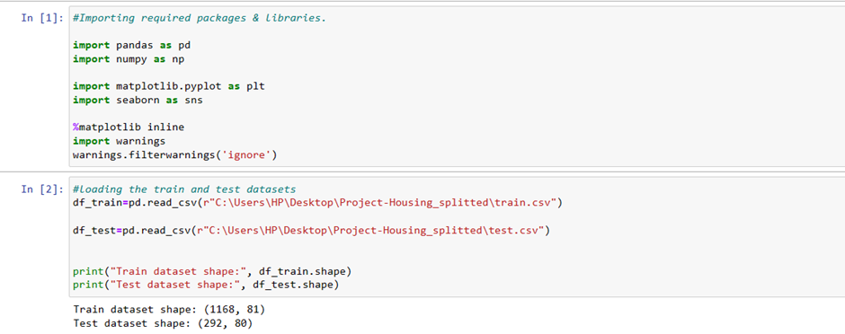
Firstly, I have imported the necessary libraries and dataset. Then I imported the train and test datasets. Checked the dimension of the dataset, data types of the features. Checked the information of the data frame using info() and checked the number of unique values present in the dataset.
Data Pre-processing

Slide 9
Data Visualizations
I have performed both univariate, bivariate and multivariate analysis to visualize the data. For analysis I have used strip plot, distribution plot, box plot and violin plot. Here I will be showing only bivariate analysis plots to analyse the data.

Slide 10
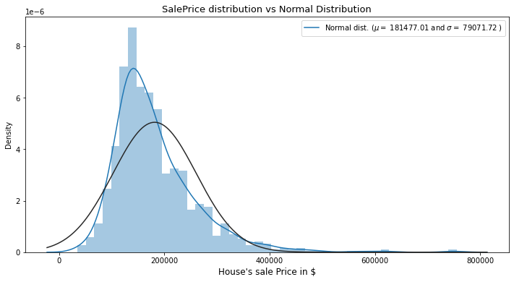
We can clearly see the plot is right-skewed. Despite that, let's leave it like that for now, we'll deal with that later in the notebook.

Slide 11
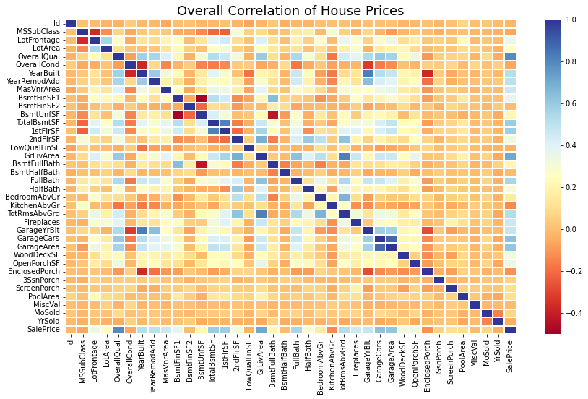
The correlation matrix is the best way to see all the numerical correlation between features. Here we can understand which features correlates most with our target variable we can investigate them more in depth.

Slide 12
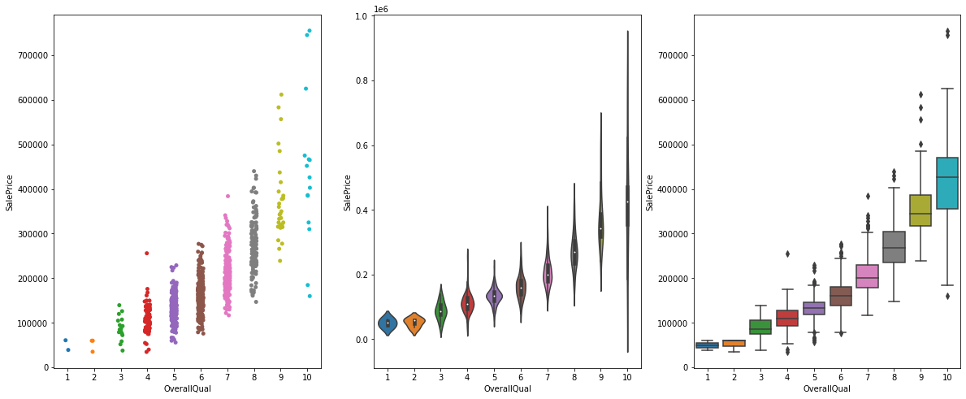
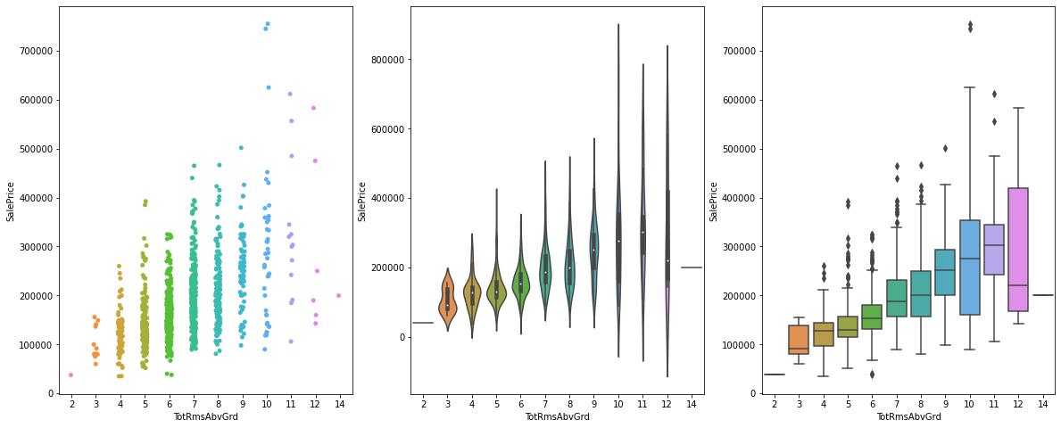
The plots help us understand the relation between SalePrice, OverallQual and TotRmsAbvGrd.

Slide 13
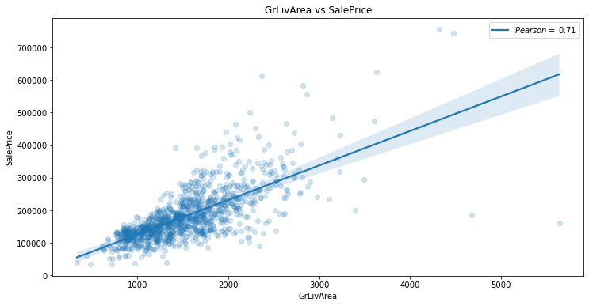
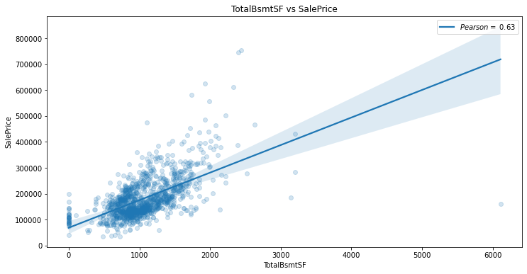
These plots help us understand how Sale Price was affected due to GrLivArea, TotalBsmtSF.

Slide 14
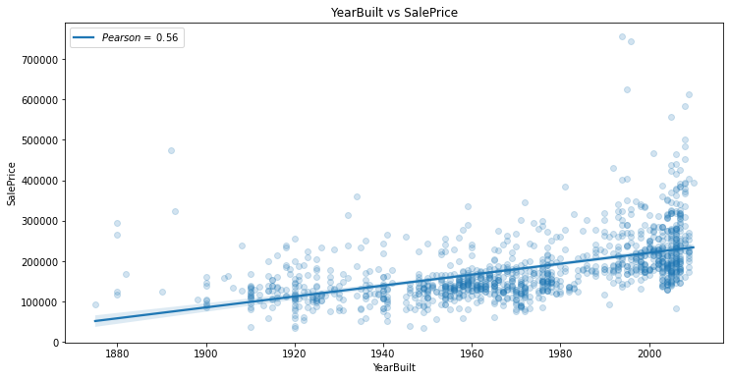
We can see that YearBuilt has an undeniable relation with the SalePrice.

Slide 15
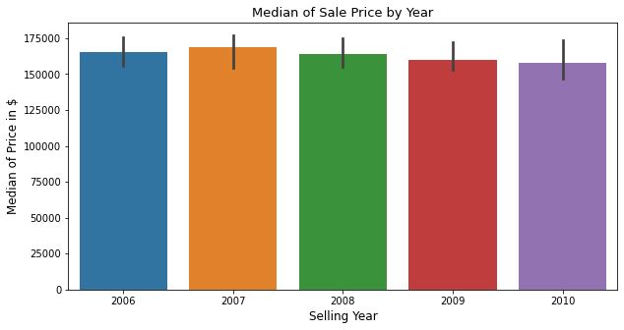
A box plot describes the Median of Sale Price by Year.

Slide 16
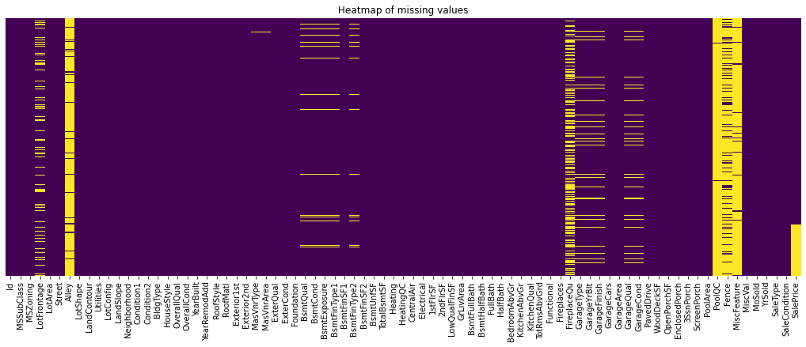
We have used heatmap to spot spotting missing values.

Slide 17
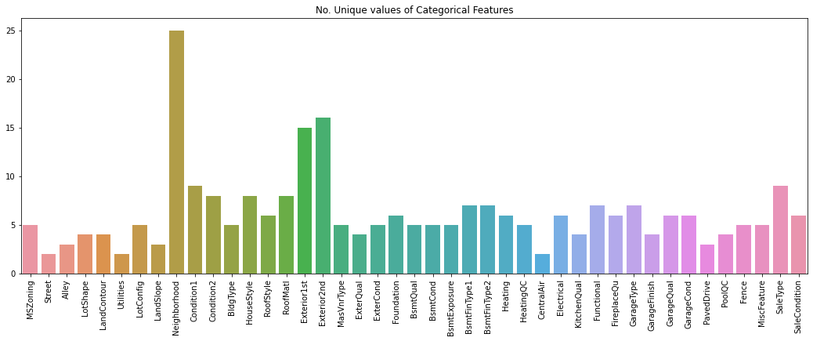
This bar plot gives us an idea of the unique values in the categorical features.

Slide 18
Interpretation of the Results
The results that were interpreted from the visualization are as follows:
The survey reveals that TotalRmsAbvGrd had greater impact than OverallQual while comparing with SalePrice.
The data also reveals that GrLivArea is more preferred than TotalBsmtSF. There is a constant relation between YearBuilt and SalePrice.

Slide 19
Findings of the Data Analysis

